Slide 1
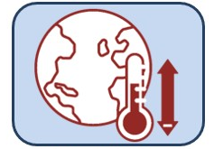

Future scenarios
Key points:
We have developed a preliminary multispecies size spectrum model for HIMI using data from the TREV project
Tool for exploring long-term climate and fishing strategy scenarios
Model description
Next steps for model development and scenarios (climate forcing, fishing)
Julia Blanchard, Romain Forestier
& TREV team
Notes:
We have developed a preliminary multispecies size spectrum model for HIMI using data from the TREV project
The aim of this work is to provide a tool for exploring the ecosystem effects of long-term climate change in the context of Patagonian toothfish fishery
In this talk we will cover some of the basic description and the model and the next steps to discuss for model development and scenarios (climate forcing, fishing)
(apologies from Julia Blanchard who could not attend)

Slide 2
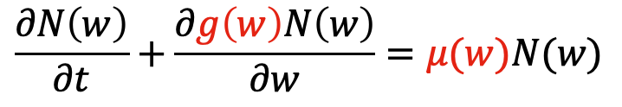
What is a multispecies size spectrum model?
Food
numbers, N
Resource (plankton, benthos)
Predation μ
N
Growth g
Size w
Stock-recruitment relation
$$\frac{∂N\left(w\right)}{∂t}+\frac{∂g\left(w\right)N\left(w\right)}{∂w}=μ(w)N(w)$$
Notes:
A very simple representation:
The model dynamics are captured by the equation at the bottom. It means that the biomass in a size class is determined by the growth by feeding and by the mortality by predation.
Because of the size structure, every interactions between individuals is size dependent so when we look at one size in particular, we find individuals from different species and at different life stages but with the same behaviour.
They will all feed on the same preys, generally hundredth time smaller, without any distinction as cannibalism is common among fish. This size structure is particularly efficient when modelling fish as it allows to model their ontogenetic growth.

Slide 3
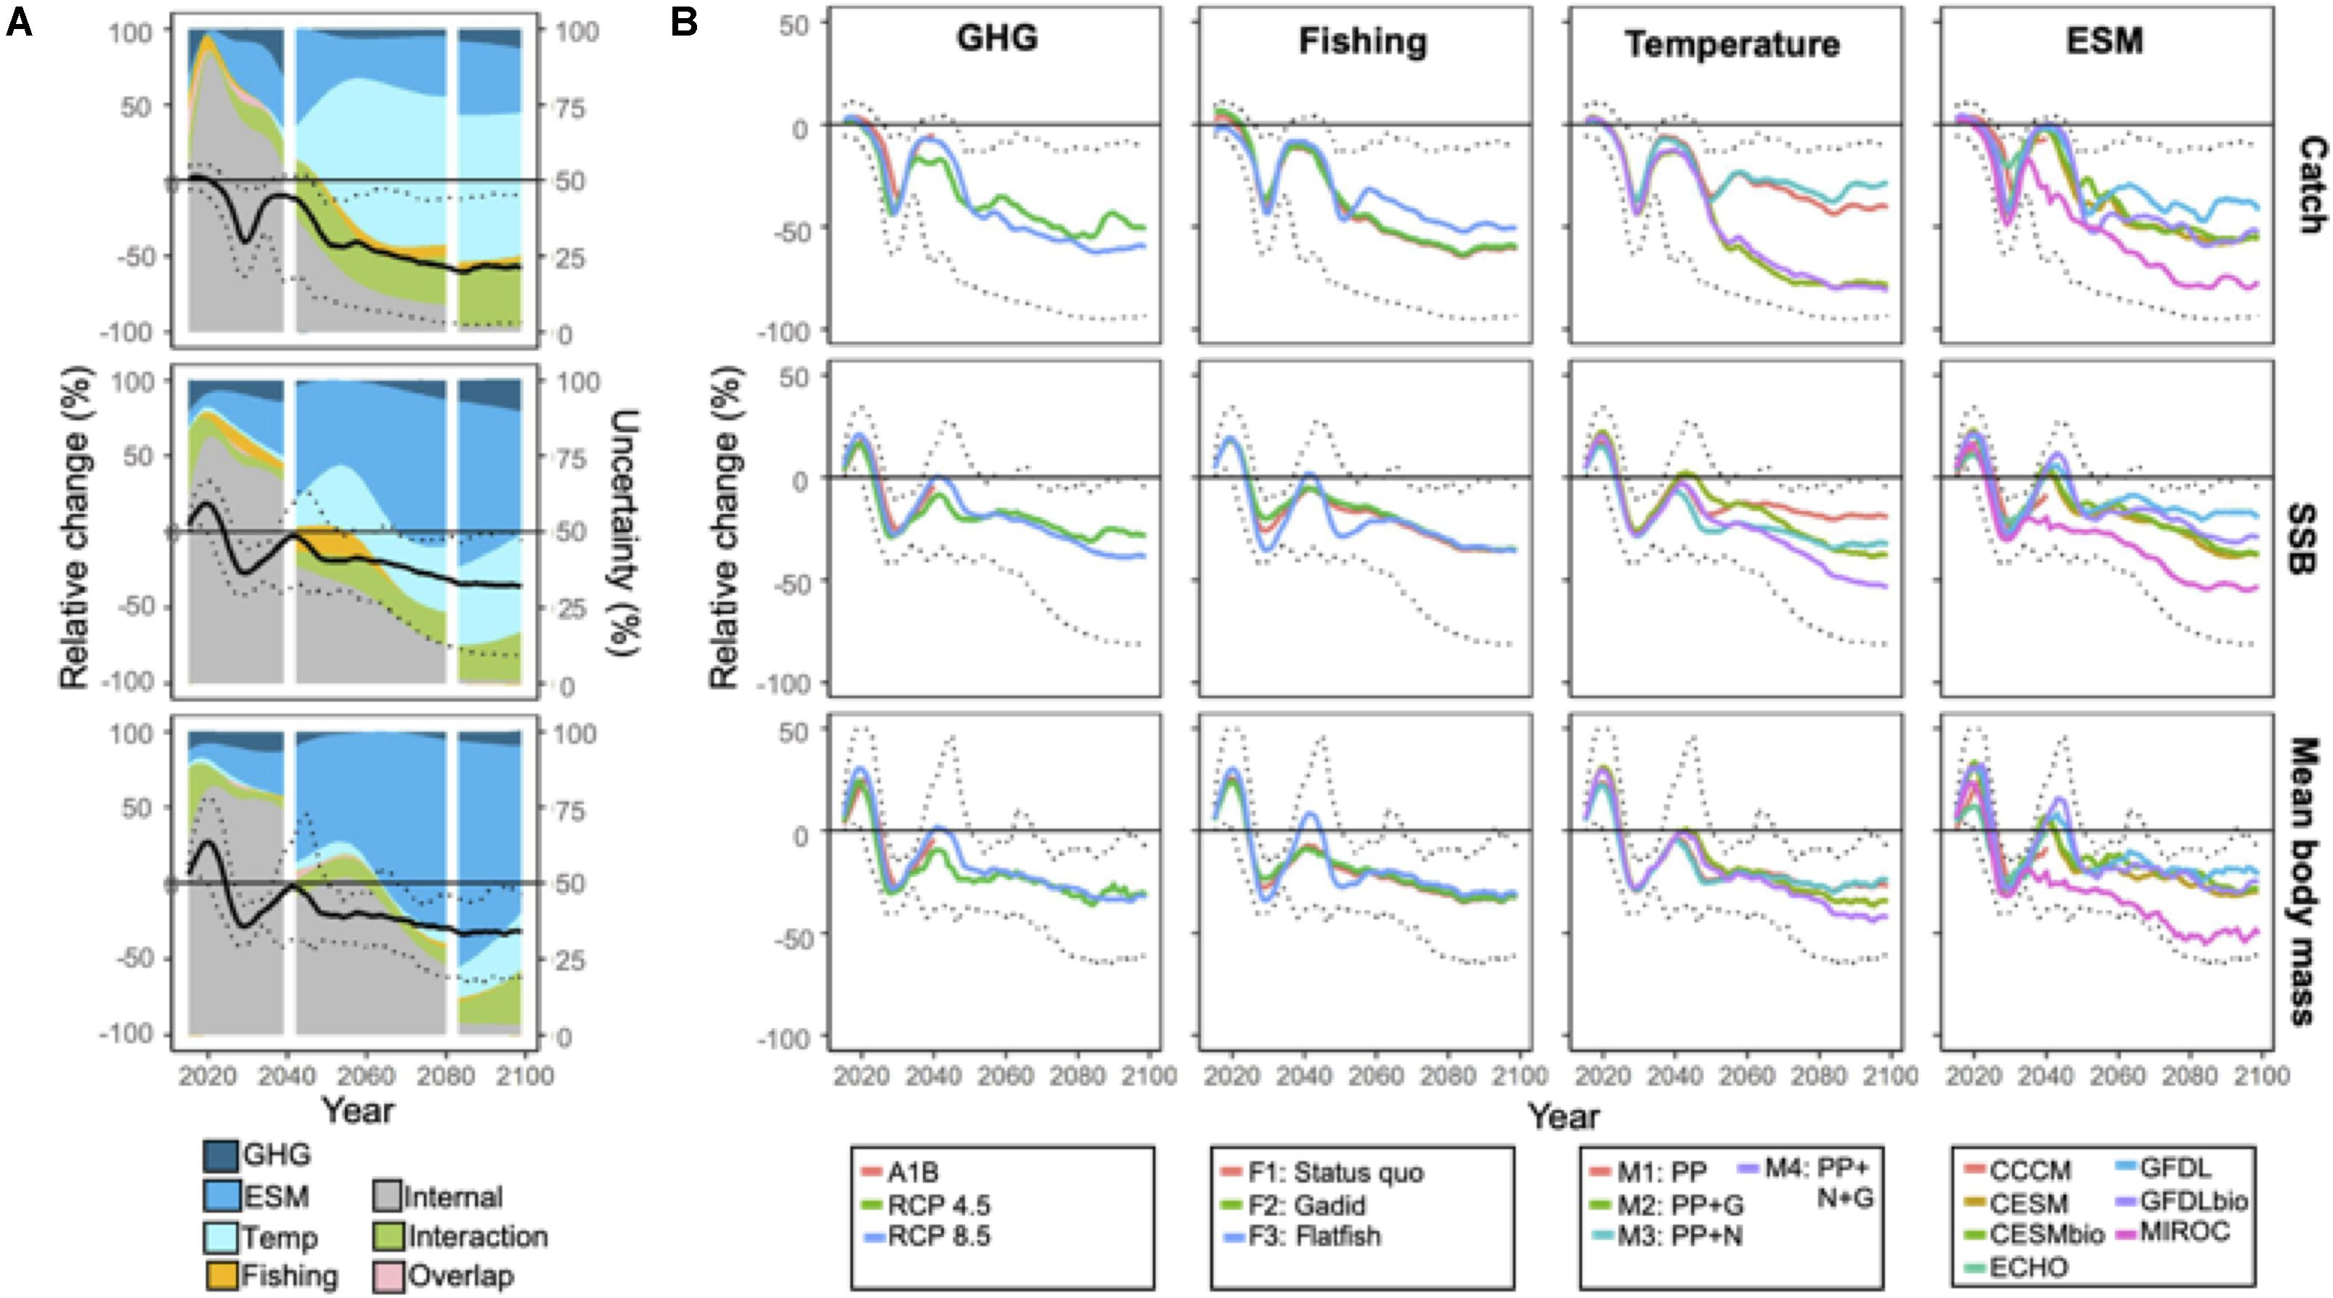
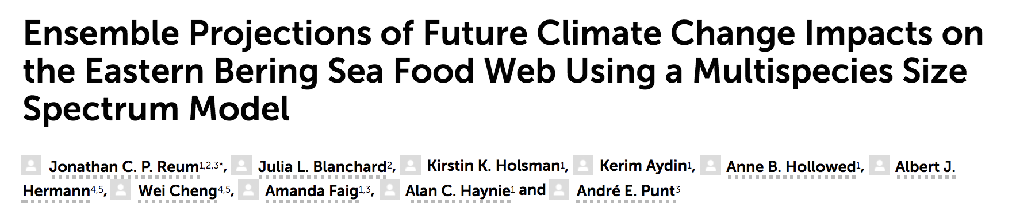
Tool for exploring fishing and climate change scenarios
Notes:
This is an example of how a multispecies size spectrum model - developed for a specific region and calibrated with data (E Bering Sea) can be used to explore log-term impacts of climate projections under alternative fishing and climate scenarios, with a focus on their relative effects and different sources of uncertainty.
Overall shows declining catches biomass and body size across all combinations of scenarios – long-term most of the uncertain from climate model forcing (ESM = Earth System Model) and how these are implemented in the ecological components of our size spectrum models (Temp, Interaction).
Reum 2020

Slide 4
Research questions
What risks will climate change pose for future sustainable fisheries and ecosystems?
More specifically: how could long-term future climate projections and scenarios inform future sustainability of Patagonian toothfish fisheries?
Are there possible changes in fisheries strategies mitigate/adapt risks?

Slide 5
Model criteria
Model of minimum to intermediate complexity
- Species’ spatial overlap and size/ontogenetic habitat-fishery interactions (spatially implicit not explicit)
- Broadly capture size-based ontogenetic food-web interactions, with a focus on toothfish
Captures demersal fish community structure, including only the most important species (relative biomass)
Enables size- and species’- selectivity of different commercial fishing gears (longline, trawl)
Captures broad-scale fisheries catches through time (long-term trends in catches)
Incorporates plausible physiological temperature effects to explore uncertainties under climate scenarios
Provides a starting point for future model development
Notes:
In TREV we developed through discussion with Nicole, Philippe, and other in AAD & IMAS “HIMI” team
Could develop these in future iterations…

Slide 6
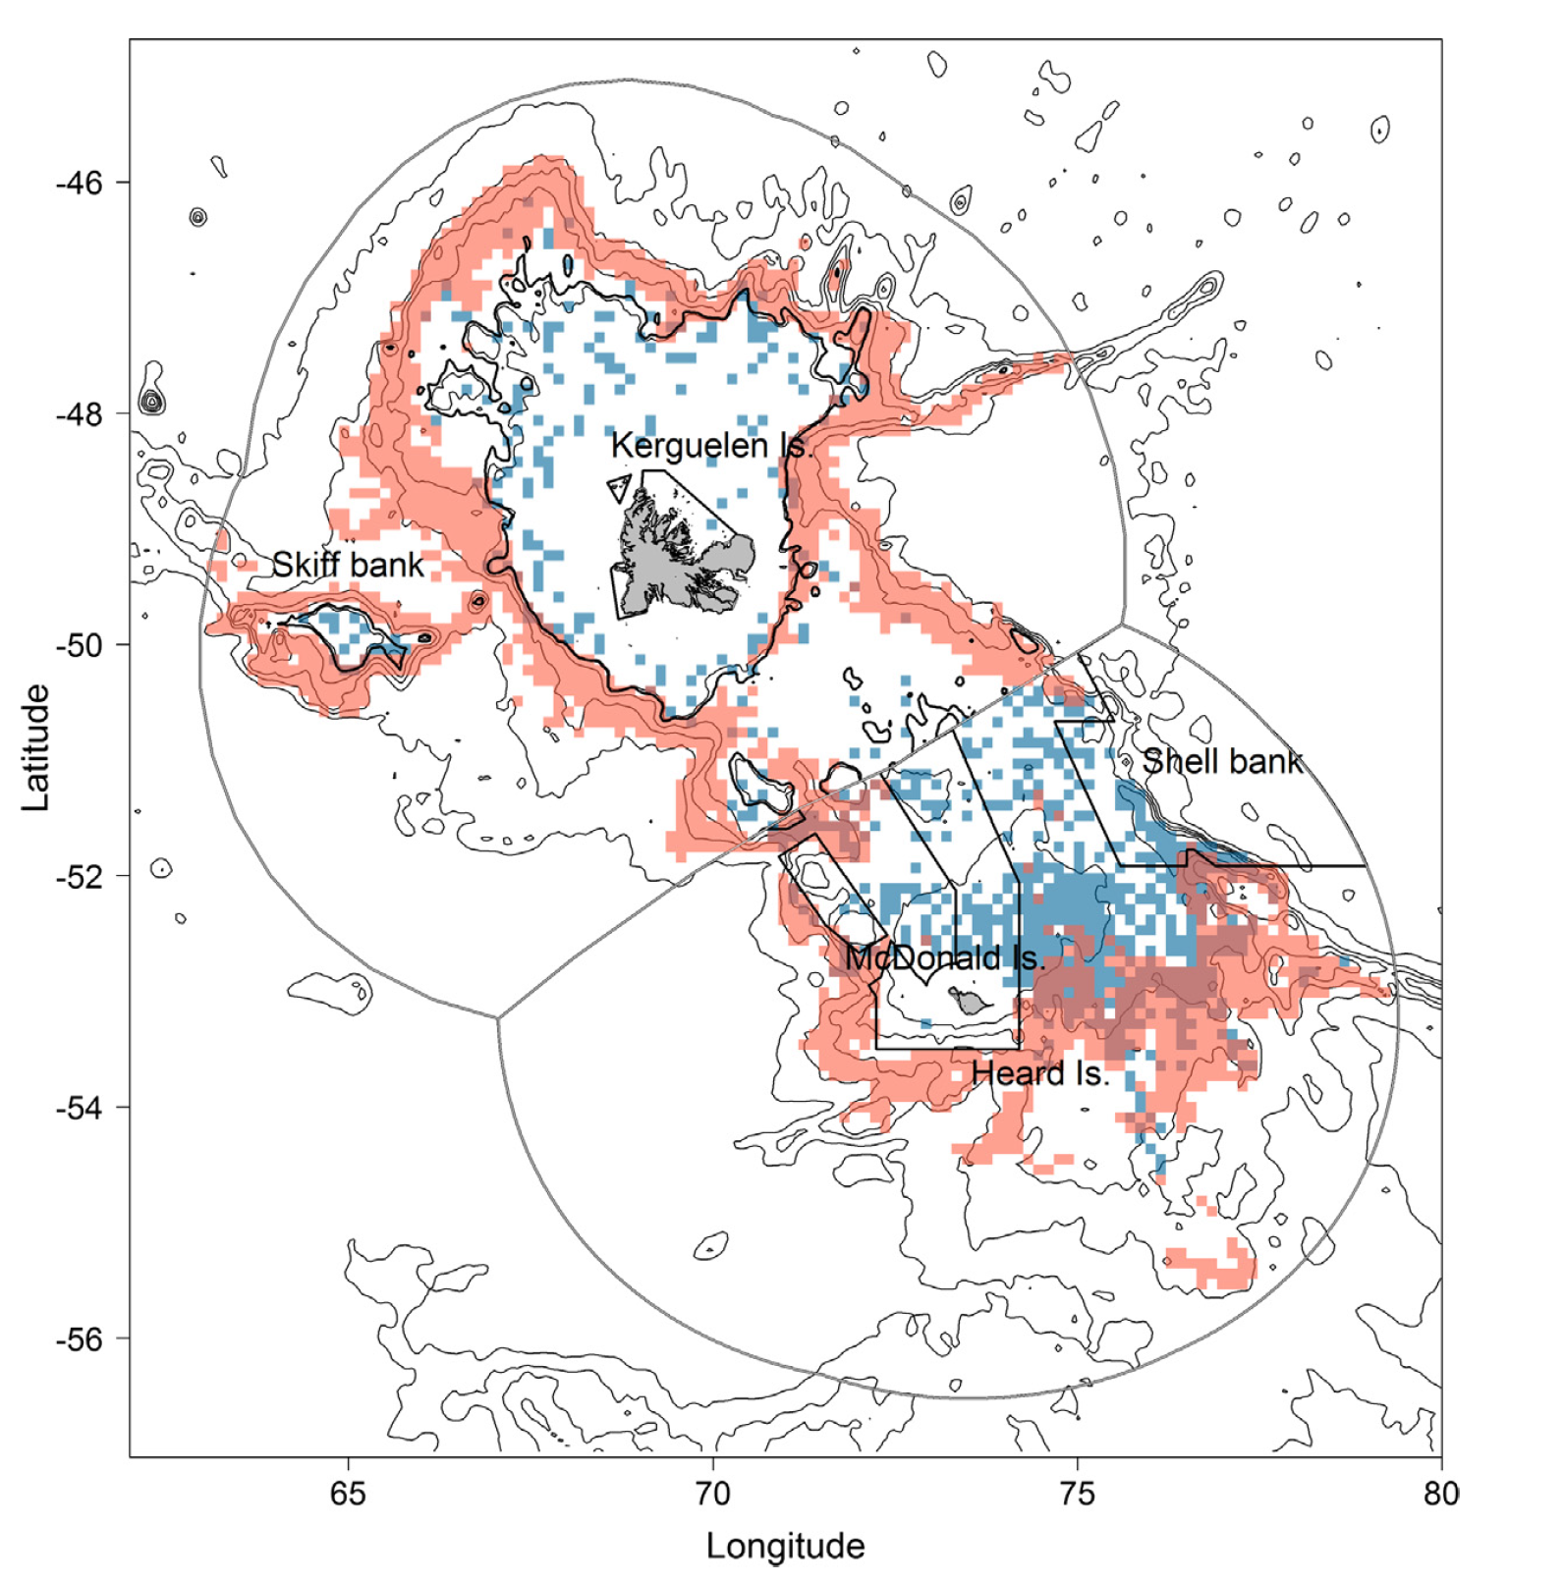
Regional data
Research surveys (demersal fish)
- relative biomass indices
Life-history traits
- literature, FishBase, AAD
Commercial long-line
- Effort and catch
Commercial trawl (toothfish)
- Not yet incorporated
Peron et al. 2016
Notes:
Focal region is the lower

Slide 7
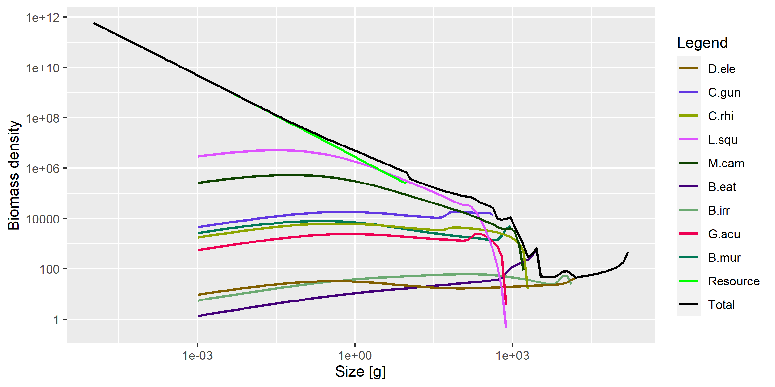
Modelled fish community structure
Notes:
Nine species plus background resource (smaller size-structured plankton and benthic sources)
These species included on basis of relative biomass
Patagonian toothfish – dark brown top in legend – largest predator in the system
Model captures full life history from size of larvae (dependent on background resource) through to maximum size
Overall community size spectrum looks reasonable (absence of fishing)

Slide 8
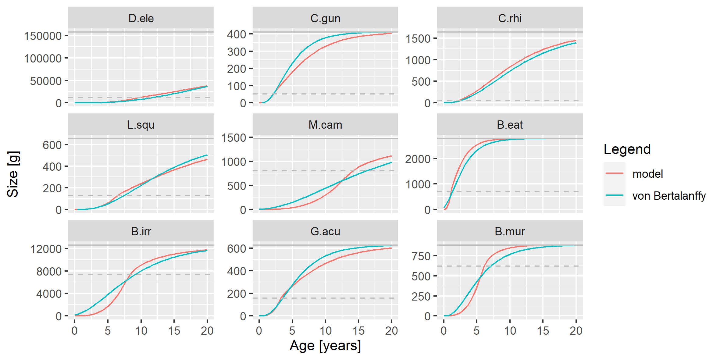
Modelled growth vs. empirical

Slide 9
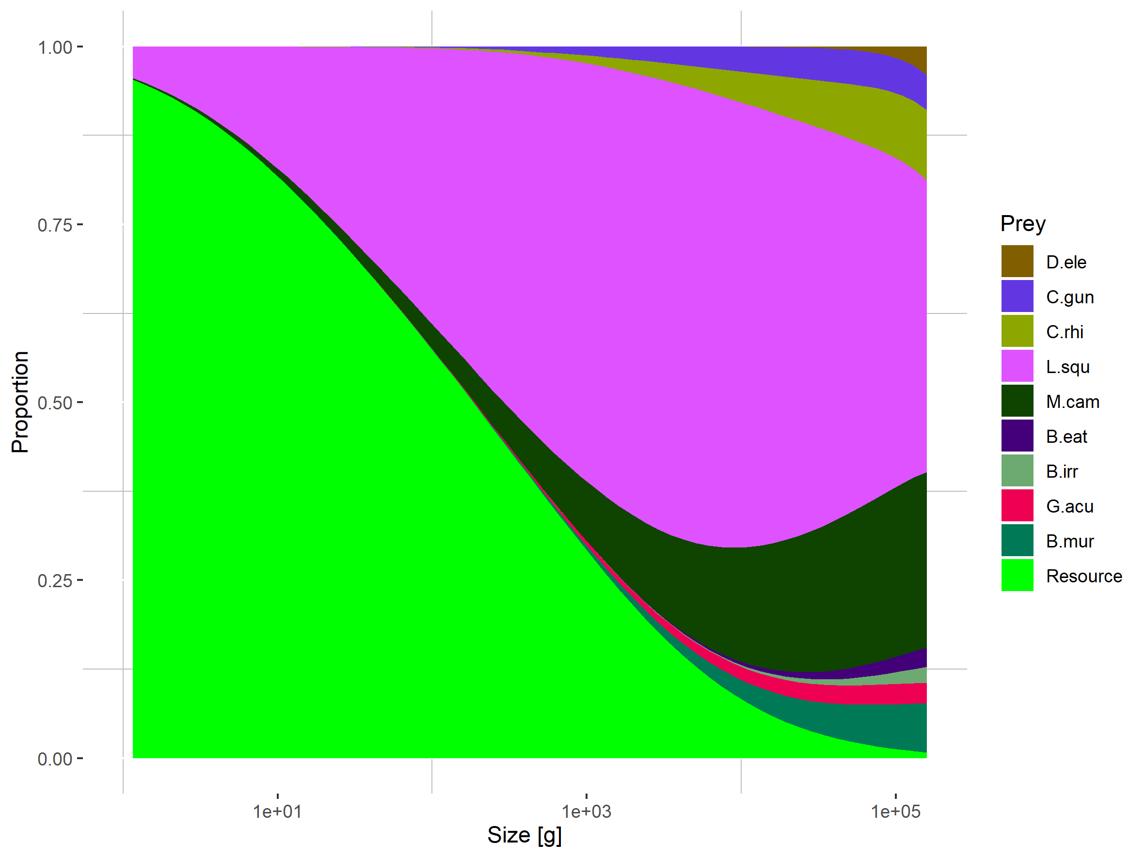
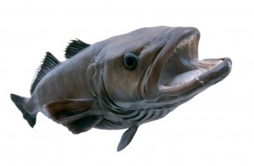
Modelled ontogenetic diet shift (Patagonian Toothfish only)

Slide 10
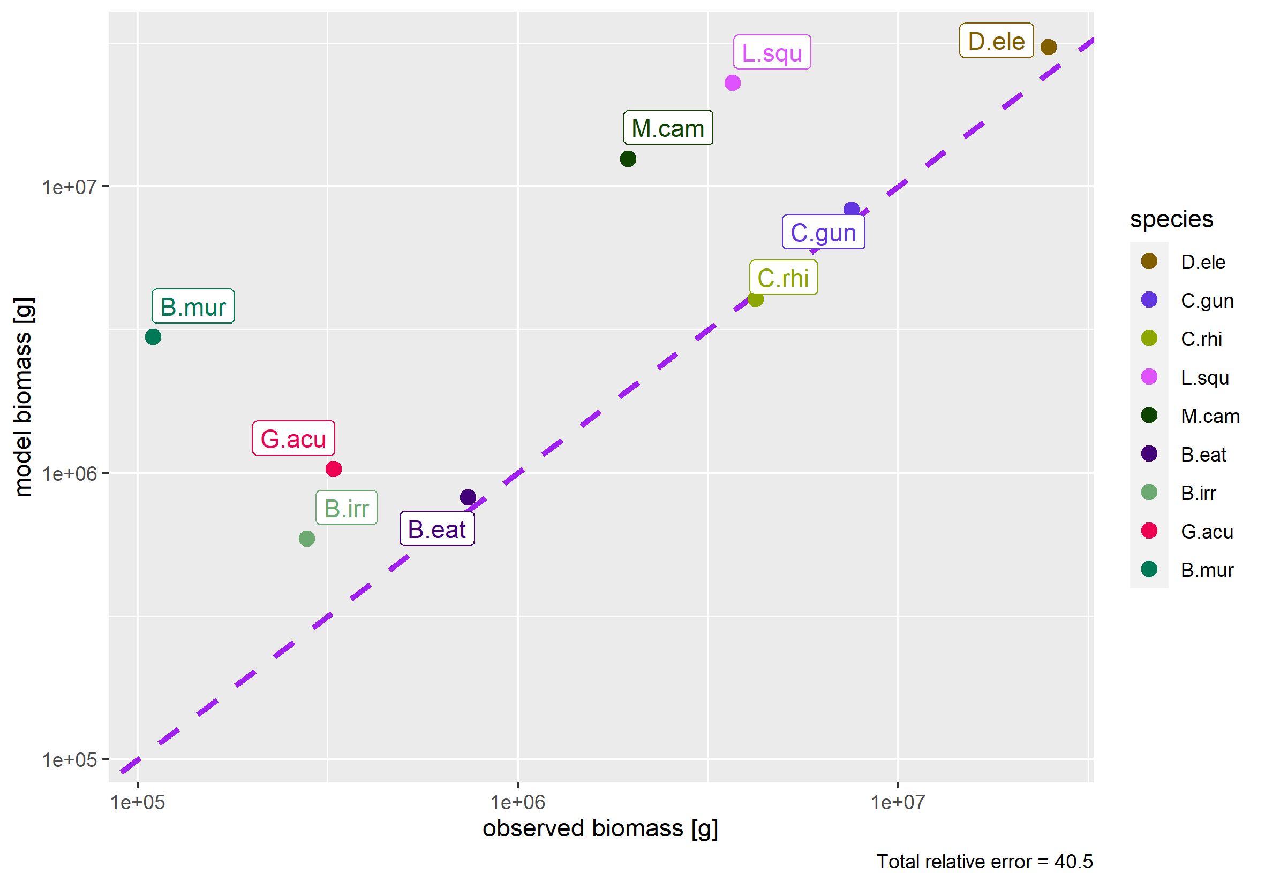
Preliminary comparison with research survey biomass indices
First peak – in the right ballpark for the most abundant species
Need to redo calibration with size selectivity of research survey accounted for in model and fishing and temperature drivers included
Notes:
Preliminary calibration to research survey biomass – needs to be refined to use an upper and lower size cutoff for calculating biomass from model that reflects size ranges captured in research survey

Slide 11
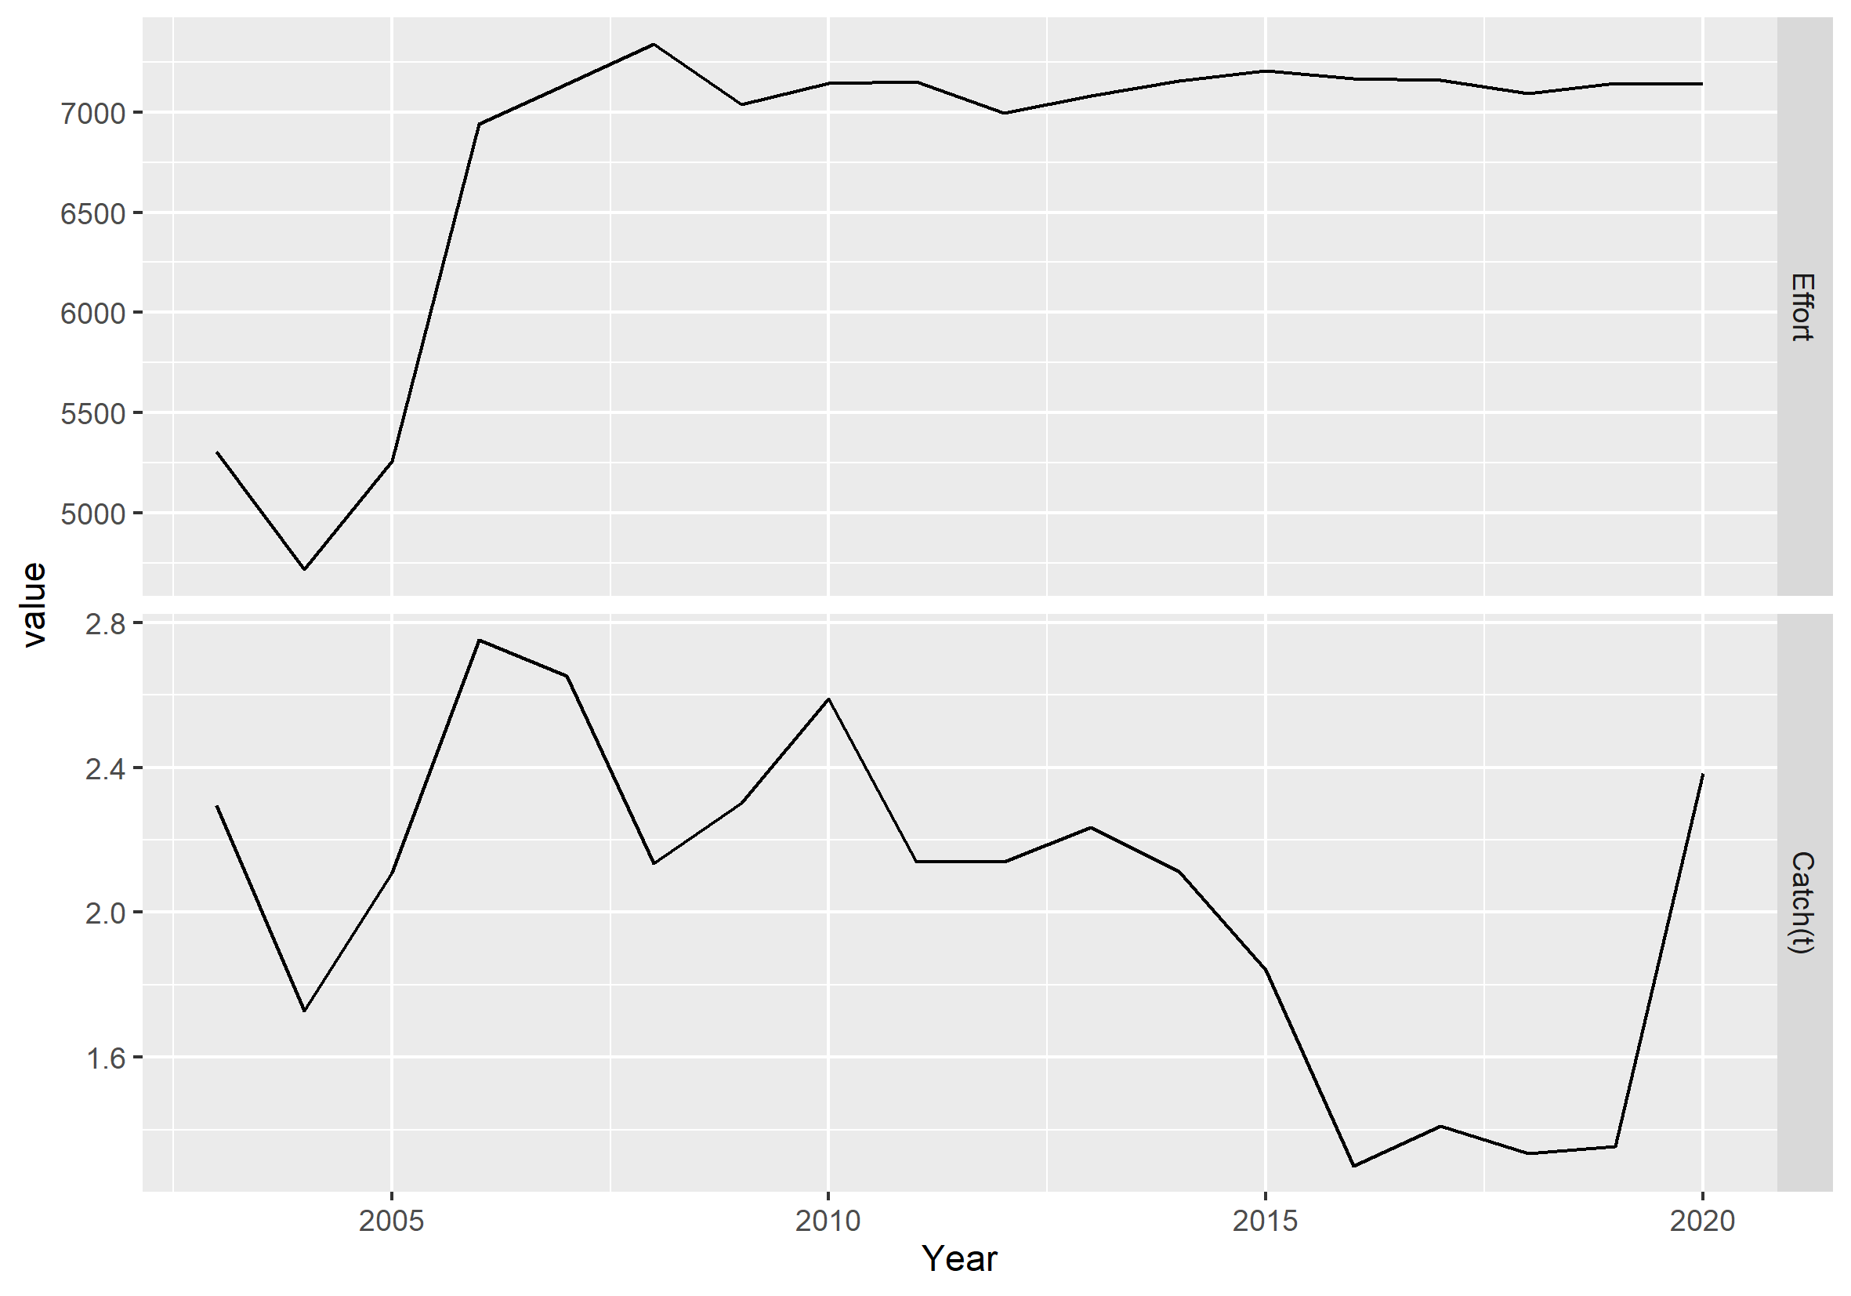
Using longlines data for time series calibration

Slide 12
Modelled yield vs. fishing mortality curve (toothfish only)
Notes:
Note that yield is in grams here…
Fmsy – instantaneous fishing mortality rate that produces Maximum Sustainable Yield (peak of yield curve) – is very small (~0.03) with collapse occurring even at 0.25
Shows modelled toothfish is v sensitive to fishing – suggests a need to check sensitivity to parameters especially the stock recruitment relationship parameters and refine calibration with additional information on fisheries

Slide 13
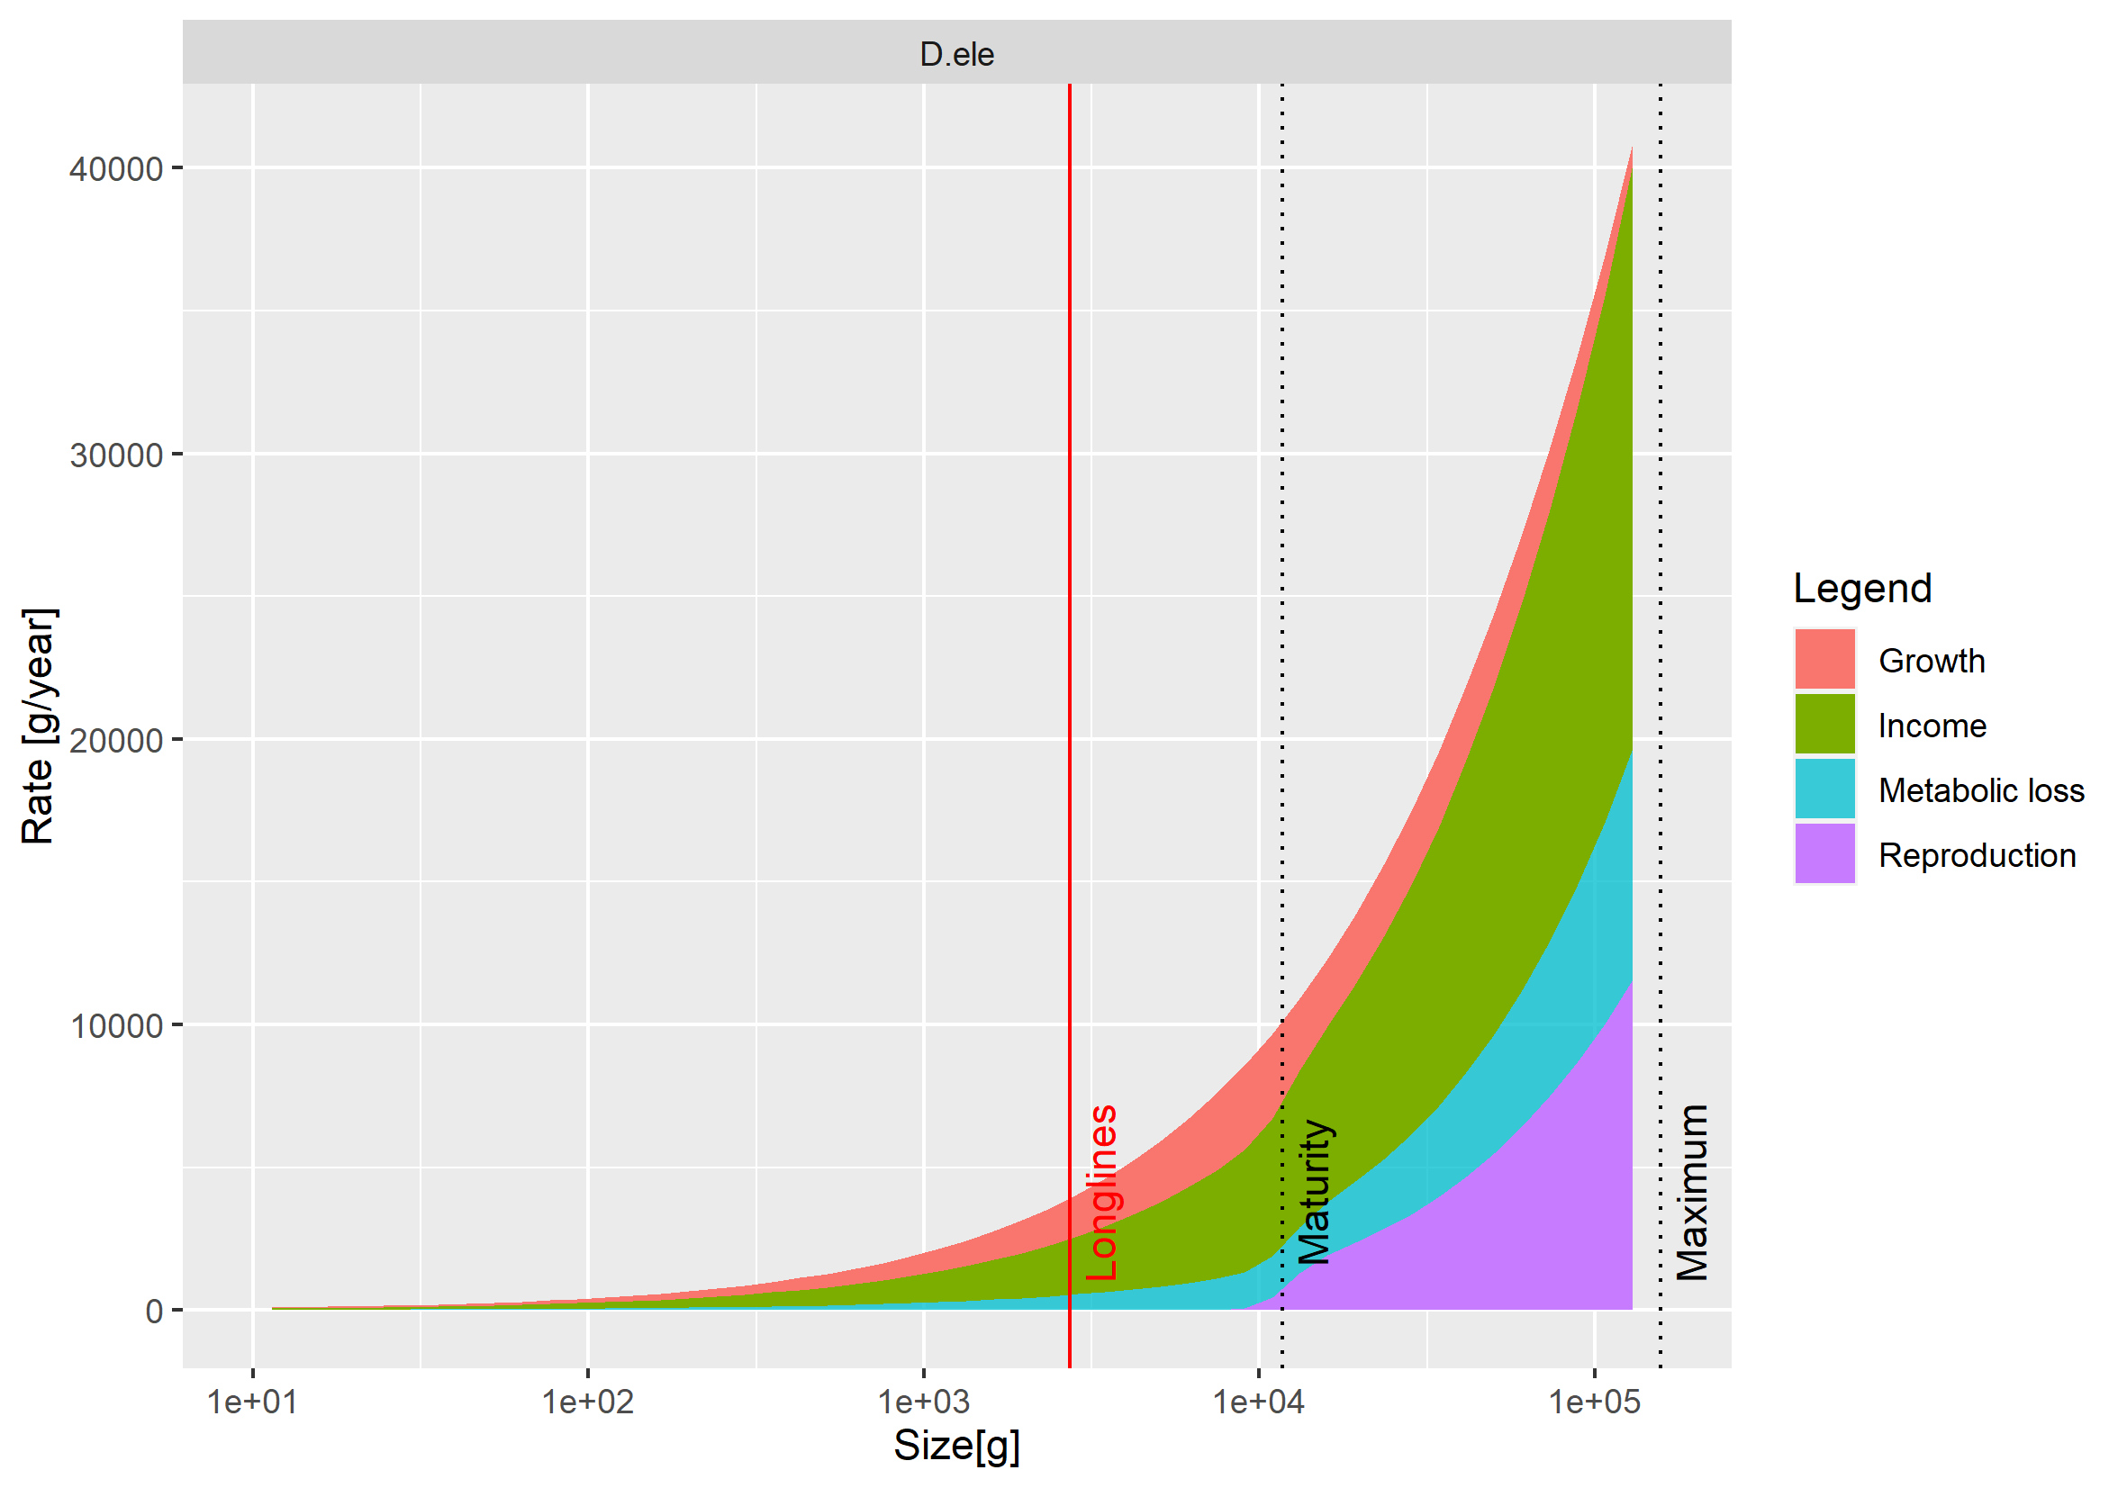
Toothfish’s energy budget

Slide 14
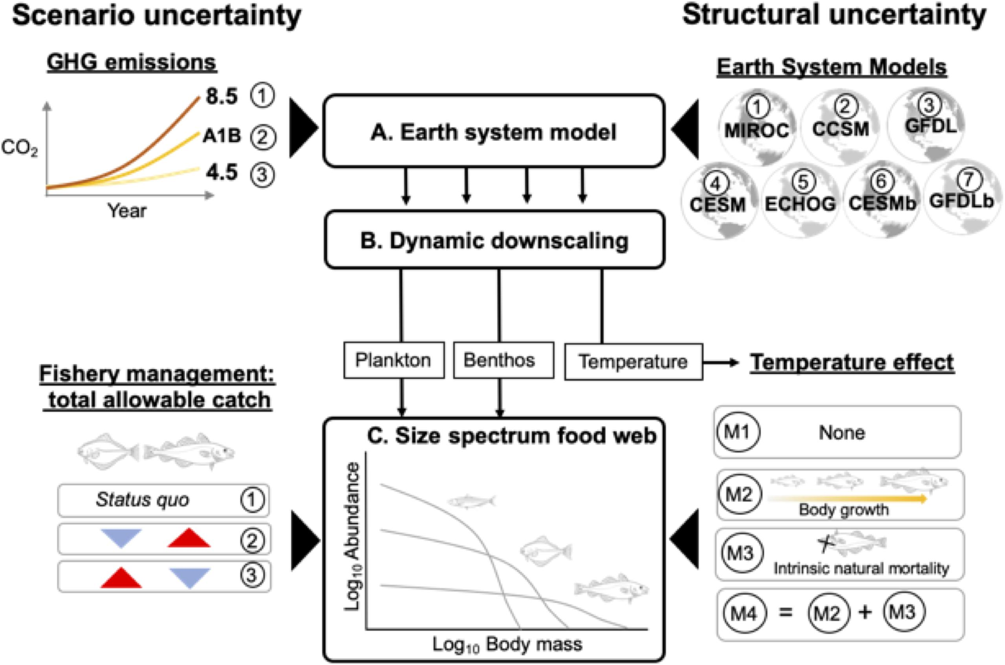

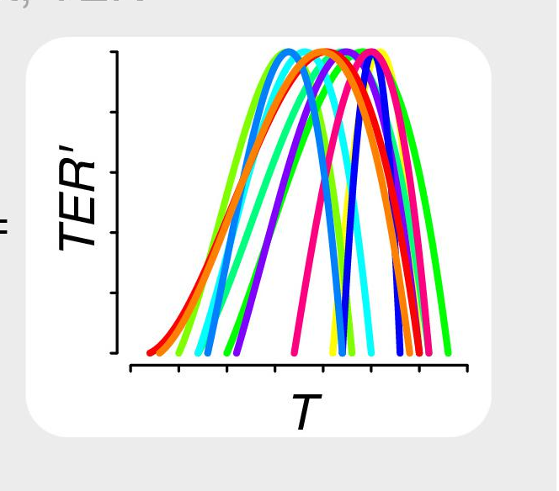
Future scenarios – framework in place
Reum et al 2020
Woodworth-Jefcoats et al 2019
Forestier et al. in prep
Lindmark et al.
Notes:
Simpler slide saying “we’re doing temperature next”
By mid august

Slide 15
Proposed scenarios (for discussion)
Climate scenarios- RCP8.5 vs. RCP 4.5
Earth System Models (CMIP6) - GFDL and IPSL outputs ready to use form FishMIP project
Climate forcing effects:
Temperature effects on individual physiological processes: (metabolism, feeding rates, mortality)
Resource (primary and secondary production?)
Fishing scenarios
Status quo vs ??
+/- catch or effort limits?
+/- species and/or size selectivities?
Fisheries and Ecosystem indicators:
Changes in: Catches, Biomass, Body Size
Notes:
Earth system modelused because they are published in the IPCC
Good for the ocean and used by fishmip and comparable to other fisheries around the world
Were using 2 systems because we get diff features, different spatial response and such
That’s 4 alternative futures
For temperature we can use default based on previous work but we are open to discussion to make it more complex
No reason to do something different though

Slide 16
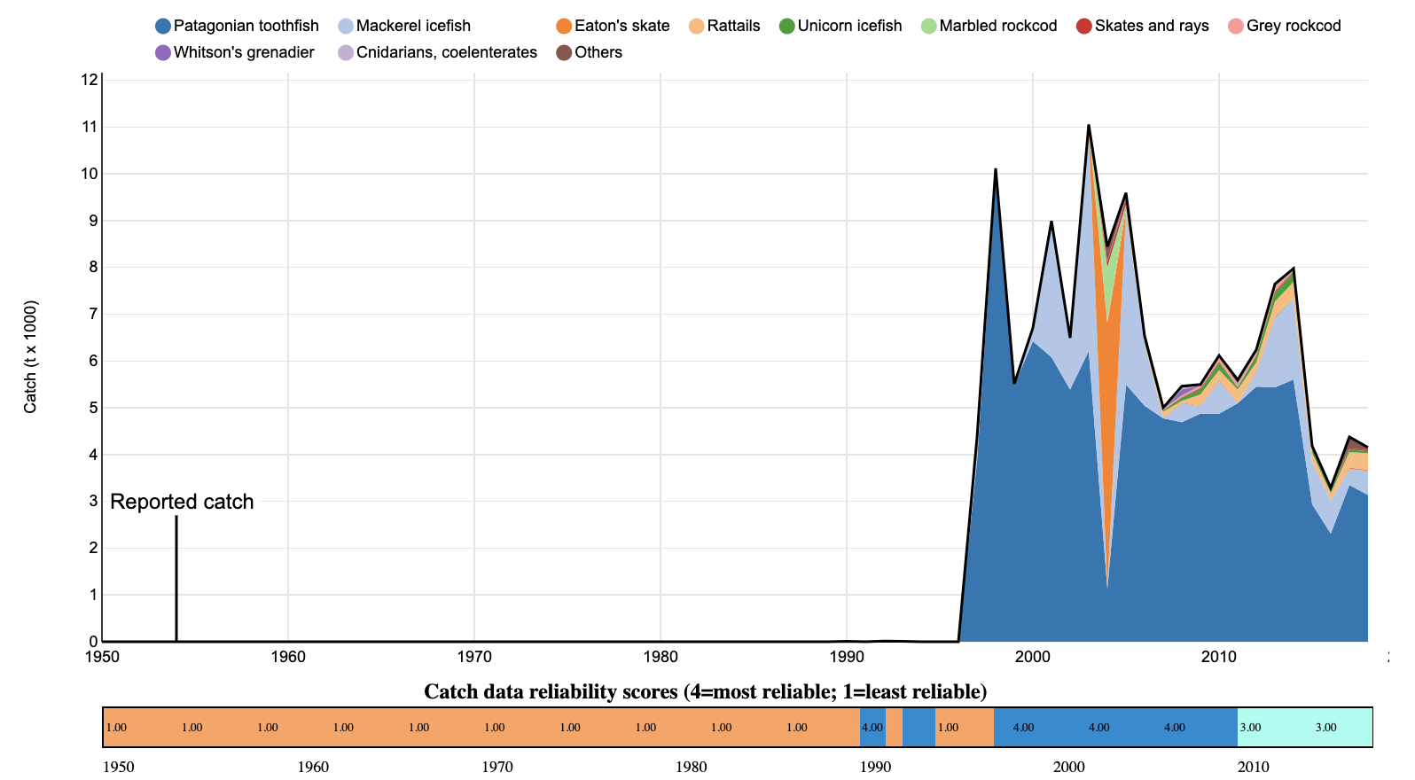
Current work – historical calibration with fishing and environmental trends through time
Notes:
Note that yield is in grams here…
Fmsy – fishing mortality rate that produces Maximum Sustainable Yield (peak of yield curve) - is

Slide 17
Sensitivity to stock- recruitment relationship parameters

